Slide 1
Brand Equity Components III: Perceived Quality

Slide 2
Overview
Defining perceived quality
Perceived quality versus actual quality
Value of perceived quality

Slide 3
Perceived Quality
Definition: A principal dimension of a brand’s positioning, perceived quality is the customer’s perception of the overall quality of the brand with respect to its intended purpose, relative to competitors.

Slide 4
Perceived Quality: “Moments of Truth”
“Each of SAS’ 10 million annual customers comes into contact with an average of five SAS employees on each flight, for approximately 15 seconds each... These 50 million ‘moments of truth’ ultimately determine whether SAS will succeed or fail as a company. These are the moments when we must prove to our customers SAS is their ‘best’ alternative.”
- Jan Carlzon, CEO, Scandinavian Airlines (SAS)

Slide 5
Pop Quiz
In your opinion, off the top of your head, what is the highest quality automobile brand?
What’s #2?
#3?

Slide 6
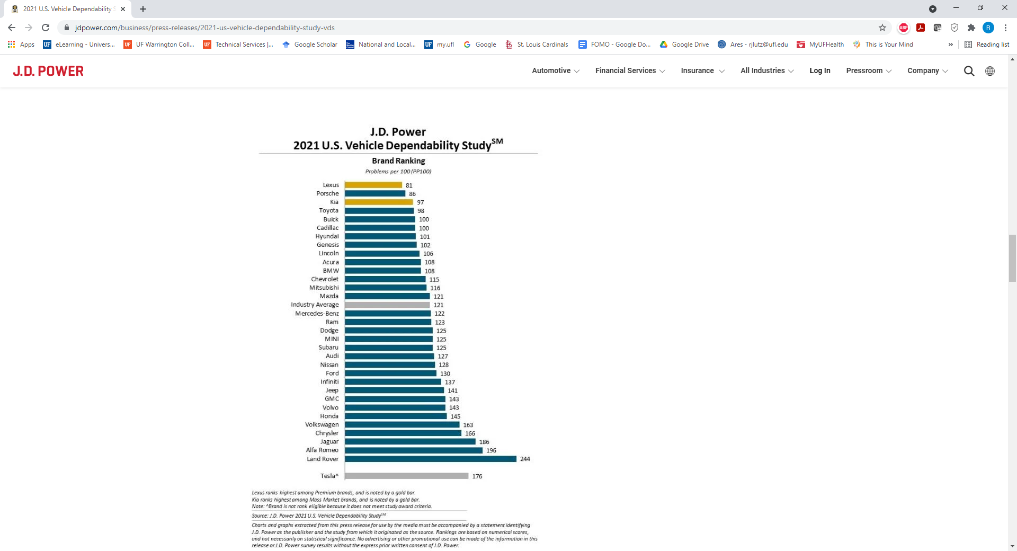
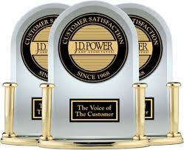
Survey said…

Slide 7
The Value of Perceived Quality
Reason-to-Buy
Differentiate/Position
Price Premium
Channel Member Interest
Brand Extensions
PERCEIVED QUALITY

Slide 8
Conclusion: How Does Your Brand Stack Up On…
Perceived quality?
Actual quality relative to competitors?
Any disparities between actual and perceived quality?

Slide 9
End of Lecture

